Slide 1
CSCE 1035 Computer Programming I Chapter 4 Branching
University of North Texas

Slide 2

4.1 If-Else Branches (General)

Slide 3

Branching as Decision Making
Branches
Let program choose between two (or more) alternatives
The decision is dependent on a condition that can be answered True or False (i.e., a Boolean expression)
When alternative courses of action are possible, each action may produce a different result
Python provides the following conditional (i.e., decision-making) statements
if statements
if-else statements
if-elif-else statements
Nested if-else statements

Slide 4
Branching Example
To calculate hourly wages there are two choices
The program must choose which of these expressions to use
Regular time (up to 40 hours)
gross_pay = rate * hours
Overtime (over 40 hours)
gross_pay = rate * 40 + 1.5 * rate * (hours - 40)
Decide if (hours > 40) is true
If it is true, then use gross_pay = rate * 40 + 1.5 * rate * (hours - 40)
If it is not true, then use gross_pay = rate * hours
Regular time
Overtime for hours over 40

Slide 5
4.2 If-Else Statement

Slide 6
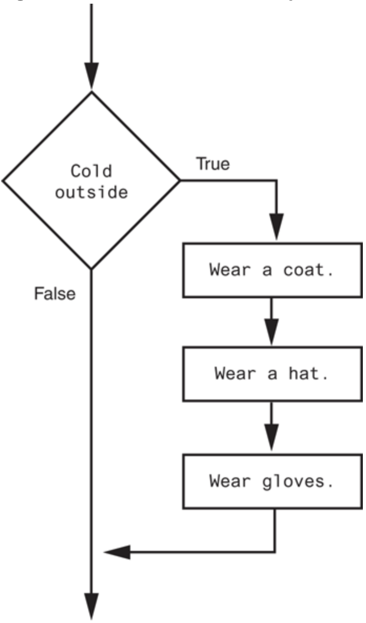
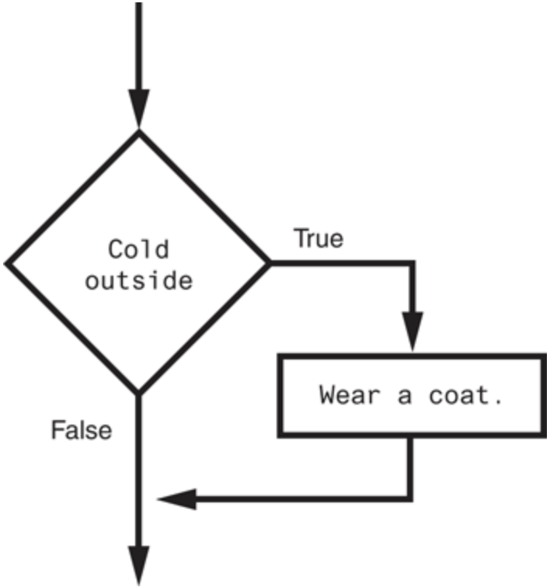
The if Statement
The if statement is used to create a decision structure, which allows a program to have more than one path of execution
The if statement causes one or more statements to execute only when a Boolean expression is true
General Format
if Boolean expression:
body
Note: Indenting the body is mandatory!
A decision structure that performs three actions
A simple decision structure

Slide 7
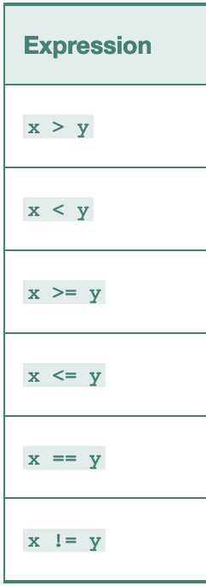
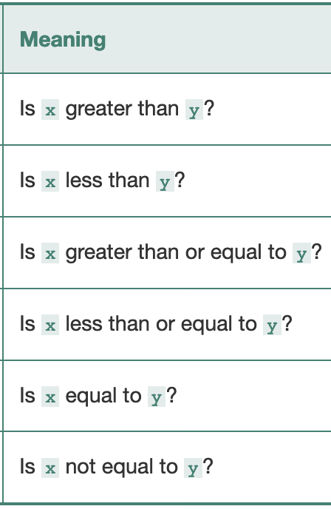
Boolean Expressions
The general format for a Boolean expression can be given in the following form:
if operand1 relational_operator operand2:
Some operand types
integer
float
string
Boolean
Some relational operators
Make sure that you are comparing operands of the same type, or at the very least they must be comparable

Slide 8

Pitfall Using = or ==
The assignment operator is =
It is used to assign values to variables
Example: x = 3
The equality operator is ==
It is used to compare values
Example: if x == 3:
Luckily, the Python interpreter will catch
if x = 3:
as a syntax error
>>> if x = 3:
File "<stdin>", line 1
if x = 3:
^
SyntaxError: invalid syntax

Slide 9
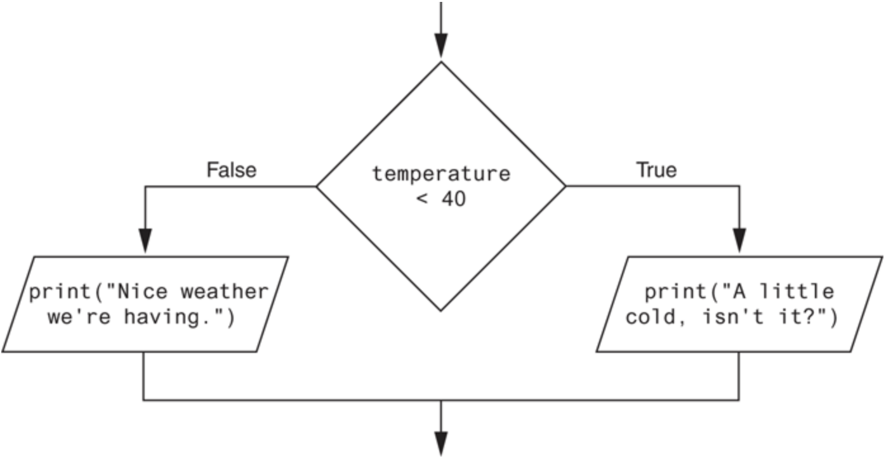
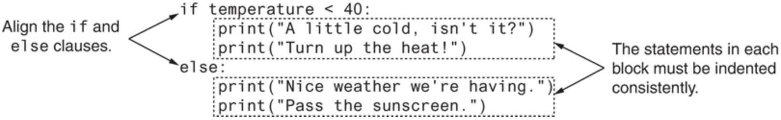
The if-else Statement
The if-else statement will execute one block of statements if the condition is true, or another block if the condition is false
General Format
if Boolean expression:
body of 'if'
else:
body of 'else'
additional statements
A dual alternative decision structure

Slide 10
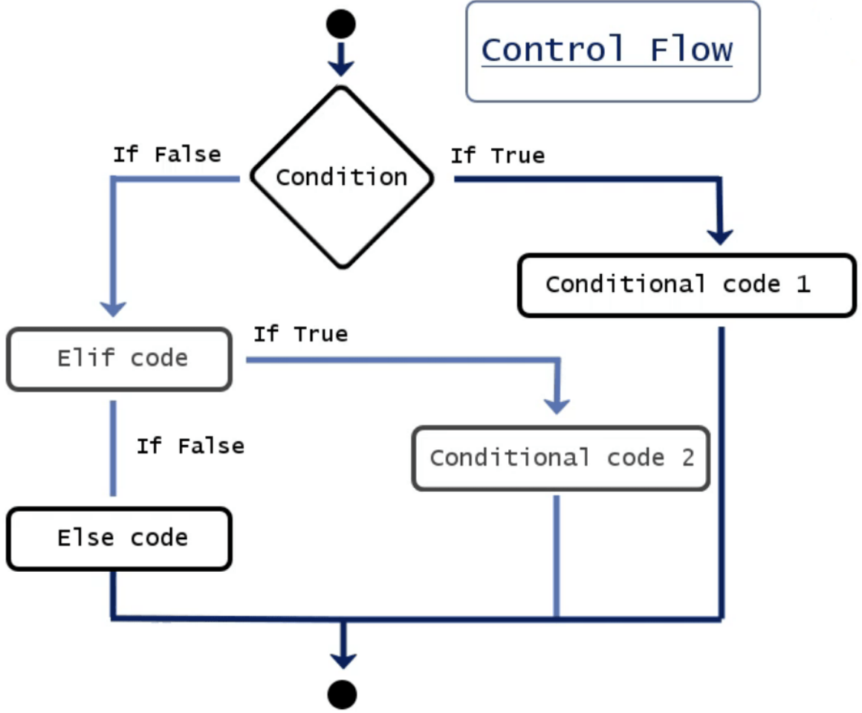
Multi-Branch if-else Statement
An if-else statement can be extended to have three or more branches using the elif statement
A chained conditional allows more than two possibilities, and thus needs more than two branches
General Format
if Boolean expression:
body of 'if'
elif Boolean expression:
body of 'elif'
… # more elif statements
else:
body of 'else'
additional statements
A Python if-elif-else ladder

Slide 11
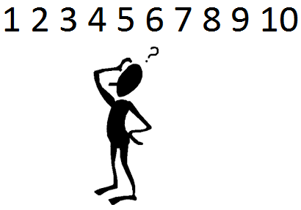
Multi-Branch if-else Statement
An if-else statement is a two-way branch
However, three, four, or even more branches can be designed using nested if-else statements
Example: Number Guessing Game
A random number is stored in variable number
A user then guesses the number, storing the result in guess
How do we give hints?

Slide 12
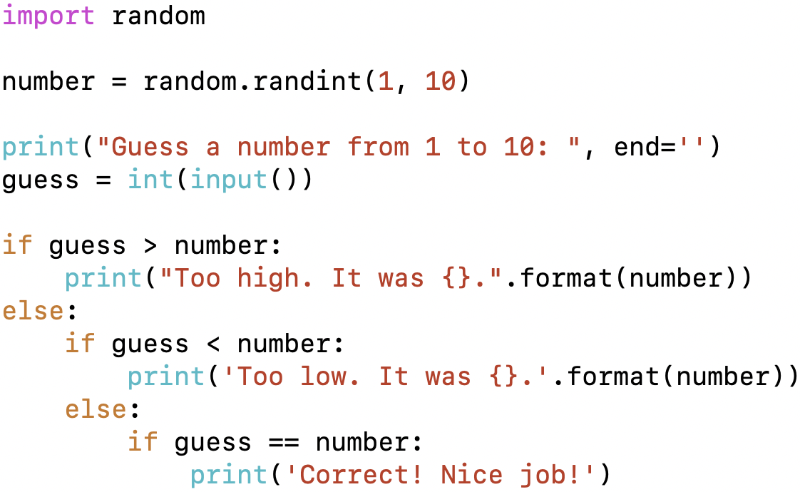
Multi-Branch if-else Statement
The following nested statements implement the hints for our number guessing game

Slide 13
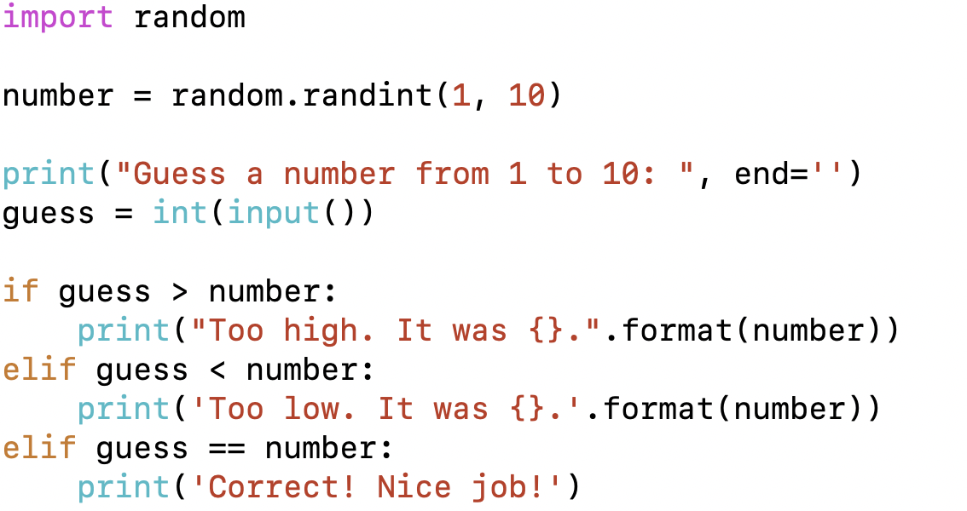
Multi-Branch if-else Statement
Notice how the code on the previous slide crept across the page, leaving less and less space
Use this alternative for indenting several nested if-else statements

Slide 14
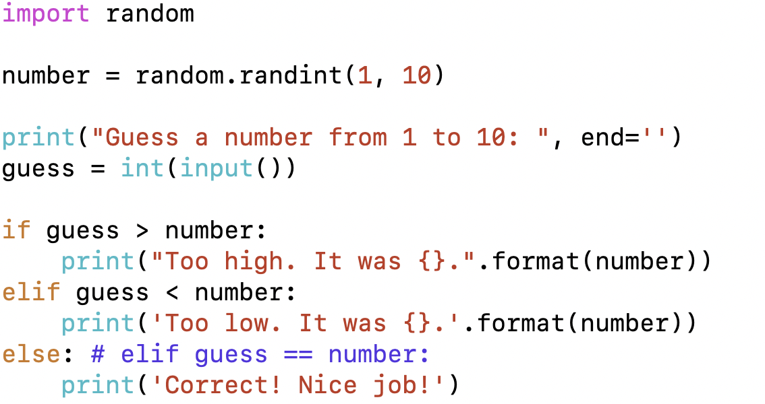
Multi-Branch if-else Statement
When the conditions tested in an if-else statement are mutually exclusive, the final elif can sometimes be omitted and replaced with a simple else
The previous example can be written as follows

Slide 15
4.3 More If-Else
(Nested if-else statements covered in Section 4.2)

Slide 16
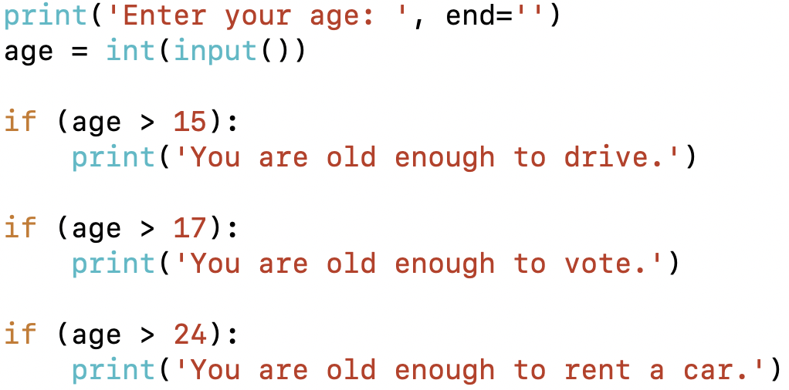
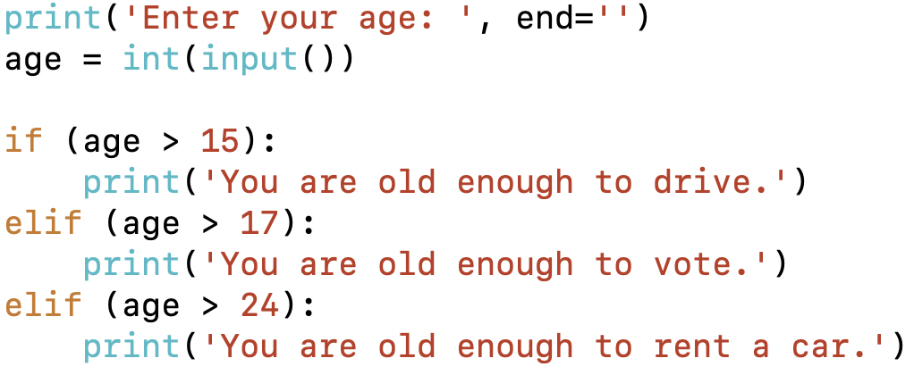
Multiple Distinct if Statements
Using multiple if statements in a sequence yields different results than nested if-else statements
Multiple if statements in sequence
Nested if-else statements
Will these yield the same result? Why or why not?

Slide 17
4.4 Equality and Relational Operators

Slide 18
Boolean Expressions
Boolean expressions evaluate to either true or false
Relational and equality operators such as > (greater than) or == (equal to), respectively, are used to compare operands
The expression hours > 40 is the Boolean expression from the wages example
A few of the comparison operators use two symbols with no spaces allowed between them
>= greater than or equal to
<= less than or equal to
!= not equal or inequality
== equal or equivalent

Slide 19
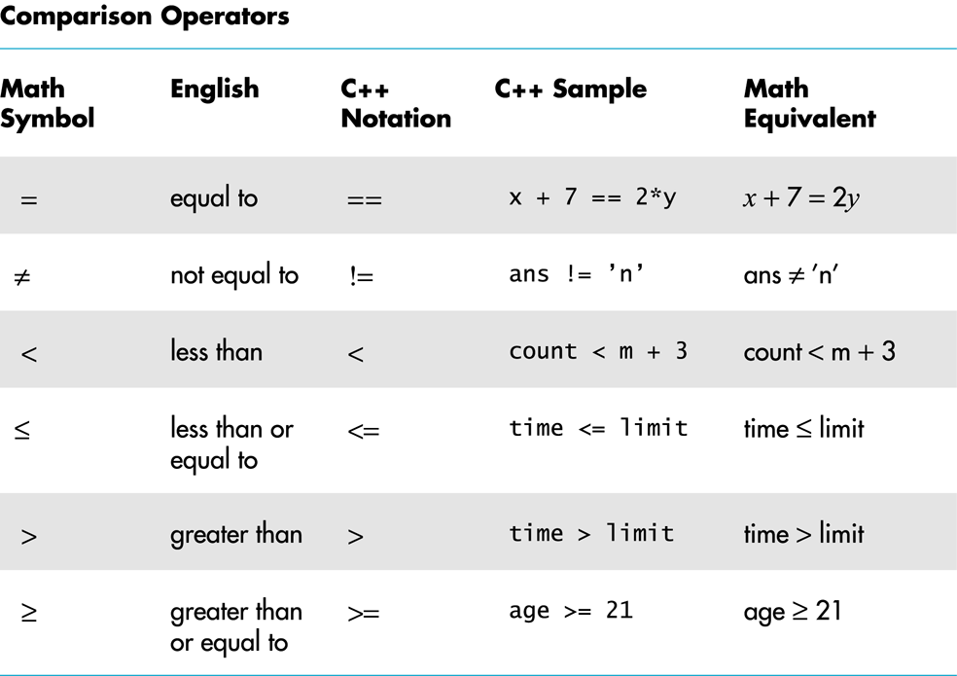
Equality and Relational Operators
Python
Python
Sample

Slide 20
Operator Chaining
In Python, comparisons can be chained together
if 0 < x < y <= 100:
This evaluates to if 0 < x, then if x < y, then if y <= 100
If 0 < x is not true, then there is no need to evaluate if x < y and so forth
This notation is common in mathematics
But not in most programming languages such as C/C++
The following both evaluate to the same Boolean value
x < y <= z x < y and y <= z
The subtle difference between them is that in the chained comparison, the y is evaluated only once

Slide 21
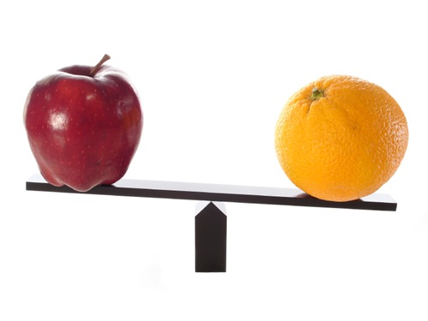
Comparison Rules
Comparisons are generally made based on type
Numbers are arithmetically compared
Strings are compared using ASCII or Unicode values and order for each character
Lists and tuples are compared via an ordered comparison of every element in the sequence
Dictionaries are compared only with == and !=
Must have the same keys and corresponding values to be true
Comparisons that make no sense result in a TypeError

Slide 22
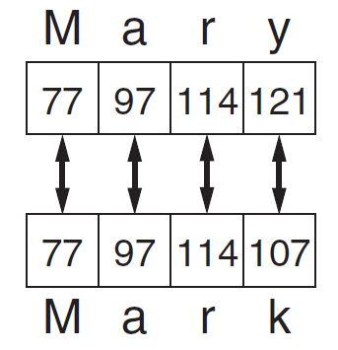
Comparison Rules (cont’d)
Floating-point numbers use < or > rather than equality ==
Remember that floating-point types are only approximations
E.g., if num = 0.50000000001, what would happen if you have the following check?
if num == 0.5:
Comparing strings
String comparisons are case sensitive
Compared character-by-character based on the ASCII values for each character
If shorter word is substring of longer word, longer word is greater than shorter word
Comparing each character in a string

Slide 23
4.5 Boolean Operators and Expressions

Slide 24
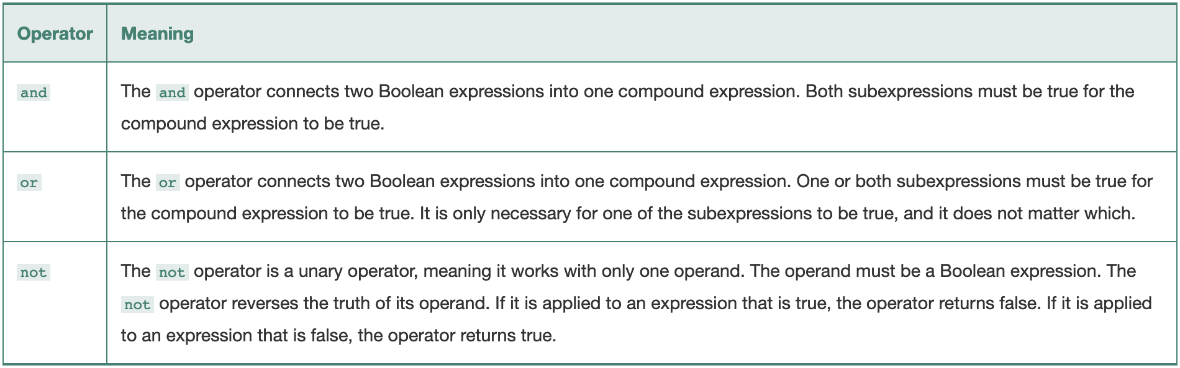
Logical Operators
The logical and and the logical or operators allow you to connect multiple Boolean expressions to create a compound expression
The logical not operator reverses the truth of a Boolean expression

Slide 25
Evaluating Boolean Expressions
The truth table is a tool for making sense of complex Boolean expressions
A | not A
True | False
False | True
A | B | A and B
True | True | True
True | False | False
False | True | False
False | False | False
A | B | A or B
True | True | True
True | False | True
False | True | True
False | False | False
For example, if y = 8, then the expression
not ((y < 3) or (y > 7))
is evaluated in the following sequence:
not (false or true) → not true → false

Slide 26
4.6 Membership and Identity Operators

Slide 27
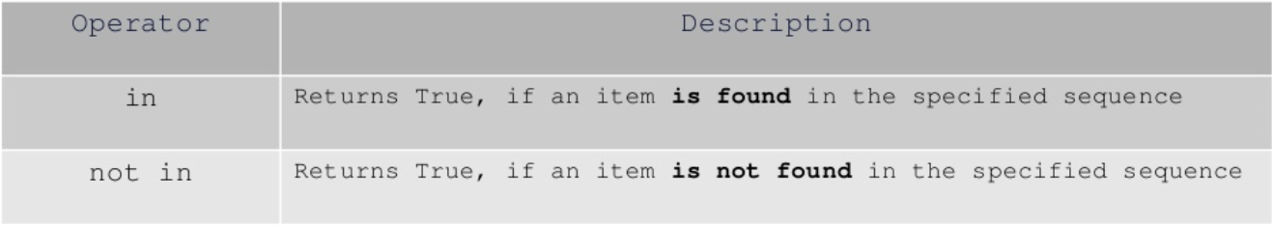
Membership Operators
Python’s membership operators in and not in test for membership in a sequence, such as strings, lists, or tuples
Can be used to check whether a substring is found in a string
>>> x = 10
>>> list1 = [21, 13, 10, 17]
>>> x in list1
True
>>> x not in list1
False
>>> str1 = 'subbookkeeper'
>>> 'book' in str1
True

Slide 28
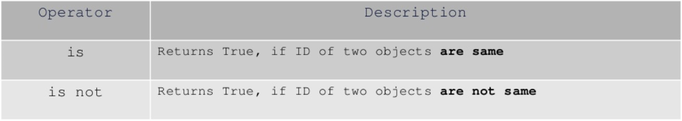
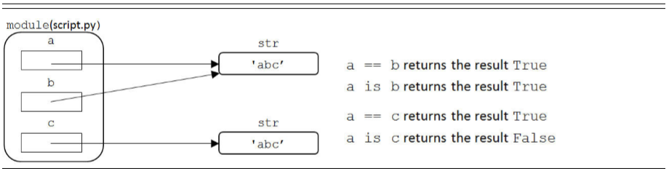
Identity Operators
Identity operators compare memory locations of two objects
Do operands on both sides of operator point to same object?
Python interpreters typically pre-create objects for a small range of numbers to avoid constantly recreating objects
Can use the id() function to get the memory location ID

Slide 29
4.7 Order of Evaluation

Slide 30
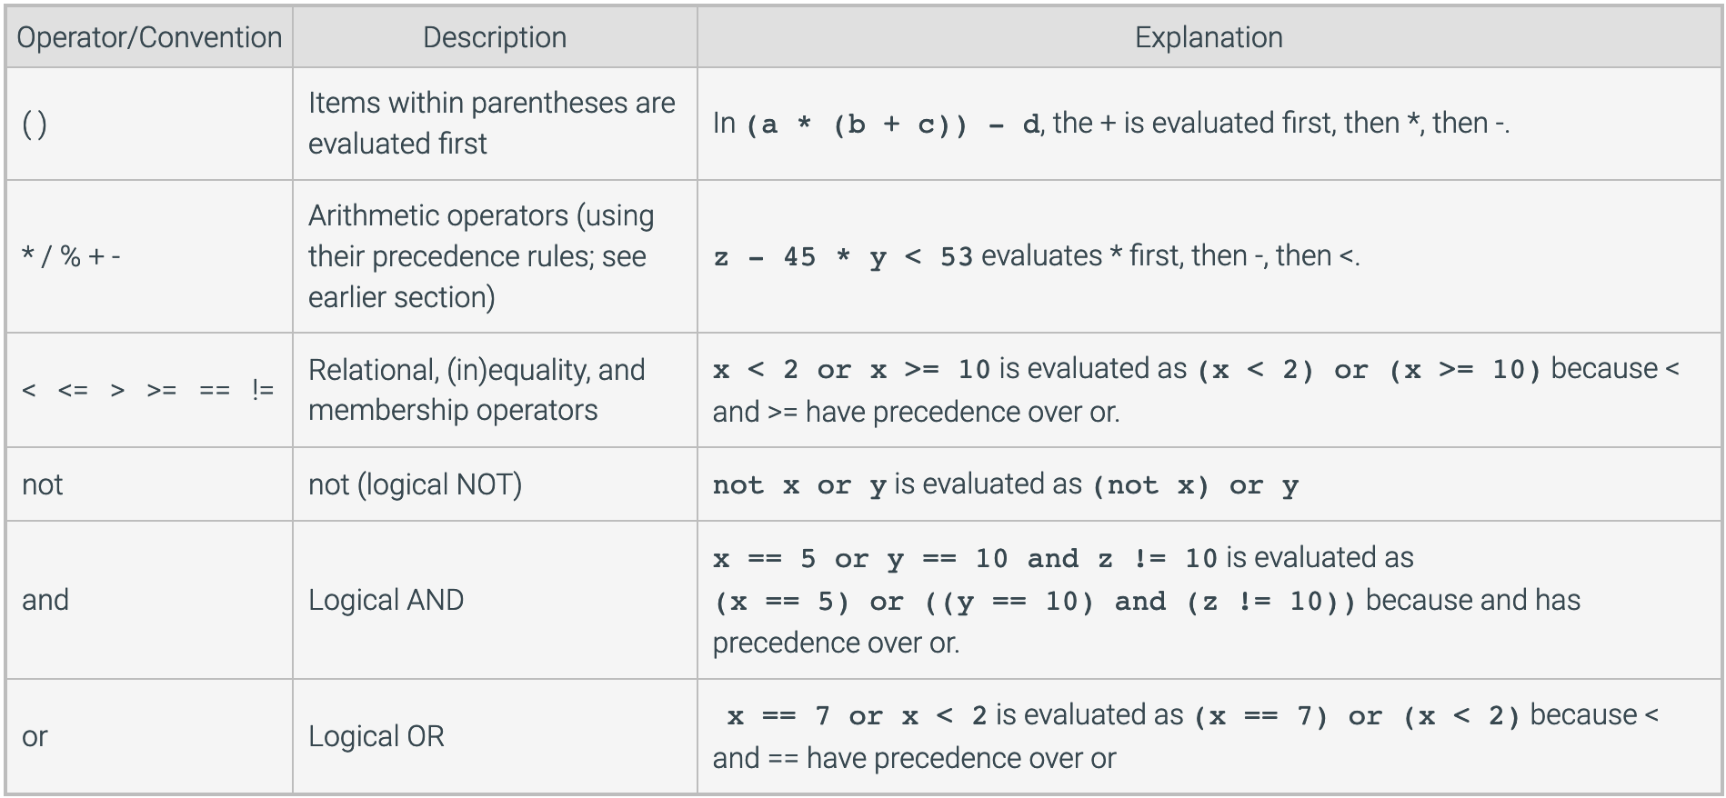
Precedence Rules
Arithmetic, logical, and relational operators are evaluated in the order shown

Slide 31
4.8 Code Blocks and Indentation

Slide 32
Python Statements
A Python statement is one instruction
Most of the time, there is exactly one Python statement per line
It is possible to have multiple statements separated by a semi-colon ; on a single line
>>> x = 4 + 6; y = x**2; print(y)
100
Doing so is not recommended as it reduces code readability
There are two ways to make a statement span multiple lines
>>> x = 4 + \ >>> x = (4
... 6 ... +
>>> x ... 6)
10 >>> x
10
Use it if it improves code readability by breaking a very long statement

Slide 33
Code Blocks and Indentation
A code block is a set of statements that will be executed together, one after the other
Code blocks have no explicit begin or end (i.e., there are no explicit braces, brackets, or keywords)
We have already seen an example of indention in if statements
Code blocks are defined by their indentation
Indenting starts a block and unindenting ends it
Lines within the code block are indented at the same level
The only delimiter is the colon : and the indentation of the code itself
Lines of code that begin a block end in a colon :
This means that white space is significant and must be consistent

Slide 34
4.9 Conditional Expressions

Slide 35
Conditional Expressions
Python also supports a conditional expression, or an inline if-else statement
With three operands, it is often referred to as a ternary operation
The middle expression is evaluated first, and based on that result, one of the expressions on the ends is returned
>>> x = 60 >>> x = 60
>>> if x >= 70: >>> grade = "pass" if x >= 70 else "fail"
... grade = "pass” >>> print(grade)
... else: fail
... grade = "fail"
...
>>> print(grade)
fail
General Format
expr1 if conditional_expr else expr2

